Slide 1

Milestone 4 – Divvy Bike Sharing Analysis
Dataset: Chicago Divvy Bike Sharing (2020 and 2019 Quarter 1,2,3,4)
Group Name: Visual Thinker
Members: Amar Sawant, Ankita K., Sultan A.

Slide 2
Introduction :
Divvy is Chicago’s official bike-sharing system, providing millions of rides each year. This dataset captures trip patterns, user behavior, and seasonal usage trends that help analyze mobility in the city.
The Divvy dataset contains detailed trip records including start/end times, stations, user types, and ride durations - that allow us to study transportation trends, commuter behavior, and urban mobility patterns.
This analysis helps reveal how Chicagoans use shared bikes throughout different seasons and regions.

Slide 3
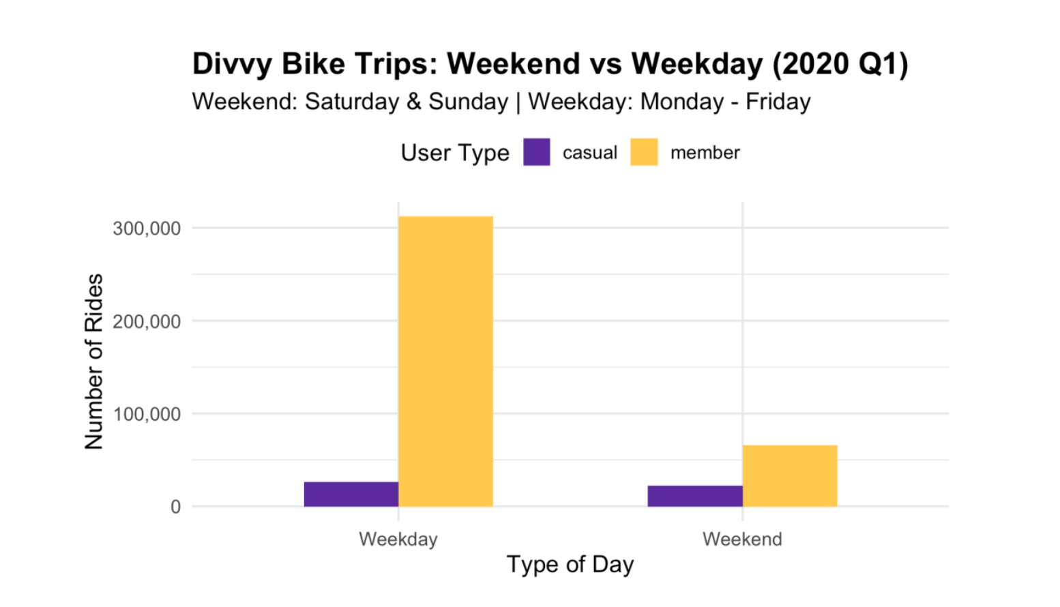
Visualization – Weekday vs Weekend Patterns

Slide 4
Observations :
Members ride mostly on weekdays.
  The large yellow bars show that members use Divvy bikes heavily during Monday - Friday, likely for work or regular commuting.
Casual riders show the opposite pattern.
  Casual users ride much less during weekdays but their usage increases on weekends.
  This suggests they use the bikes more for fun, leisure, or exploring the city.
Weekends are quieter overall.
  Total rides drop on weekends because members, who make up the majority, ride less during their days off.

Slide 5
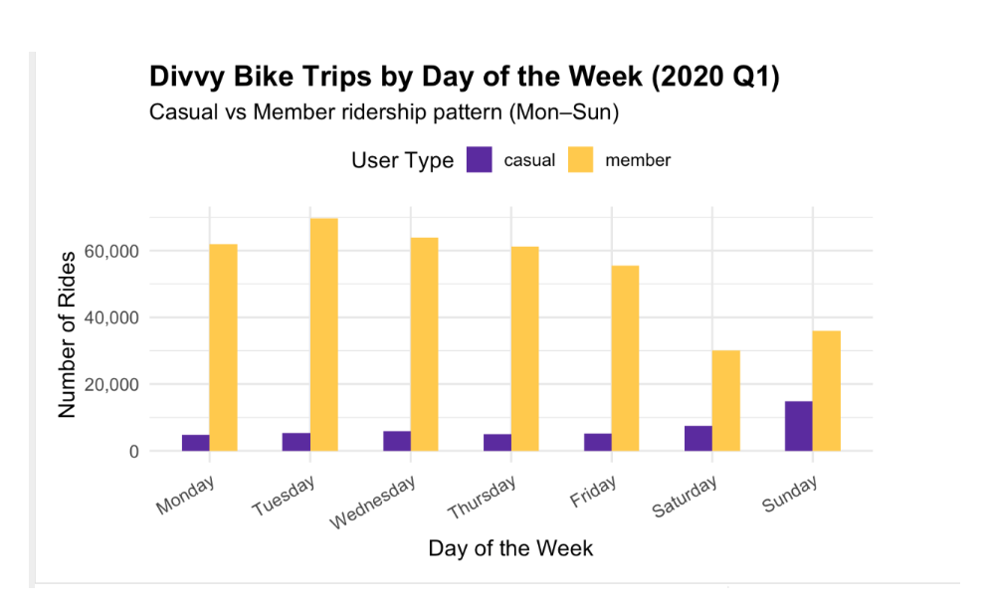
Alternate Visualization 1

Slide 6
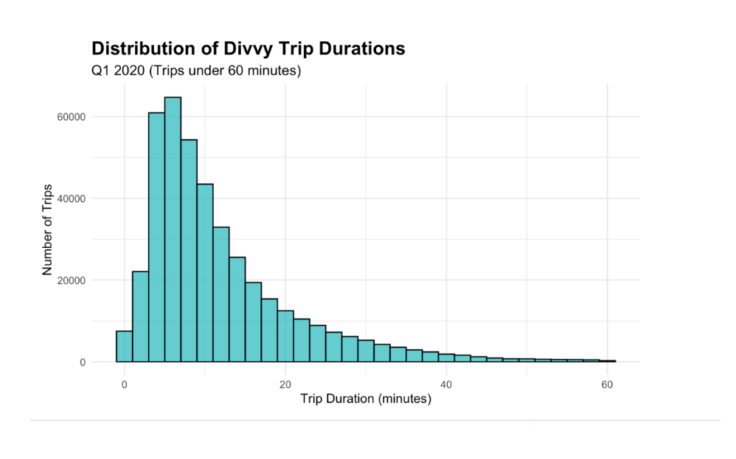
Visualization 2 : Distribution of Divvy trip durations

Slide 7
Observation :
Trip Duration Pattern: Most Divvy bike trips are relatively short, typically concentrated in the 0-30 minute range
Peak Duration: The highest frequency of trips likely falls between 5-15 minutes (typical for urban bike-share usage)
User Behavior: Short trips suggest the bikes are primarily used for:
  Quick commutes
  Last-mile transportation
  Short errands or point-to-point travel

Slide 8
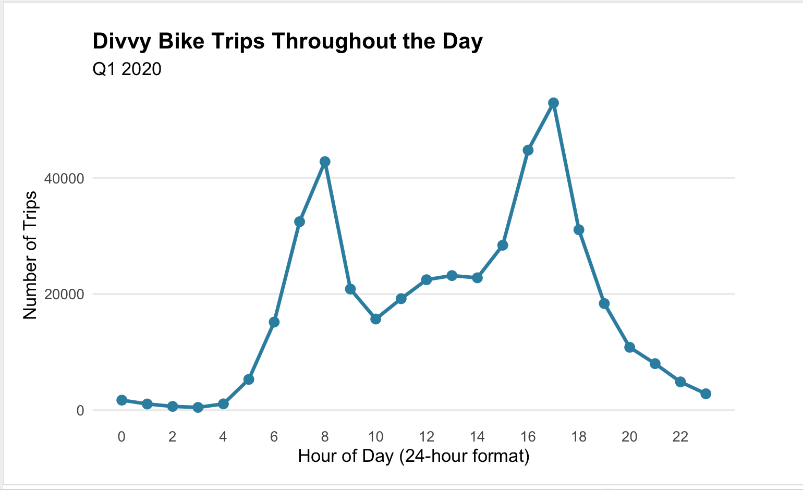
Visualization 3 – divvy trips throughout the day

Slide 9
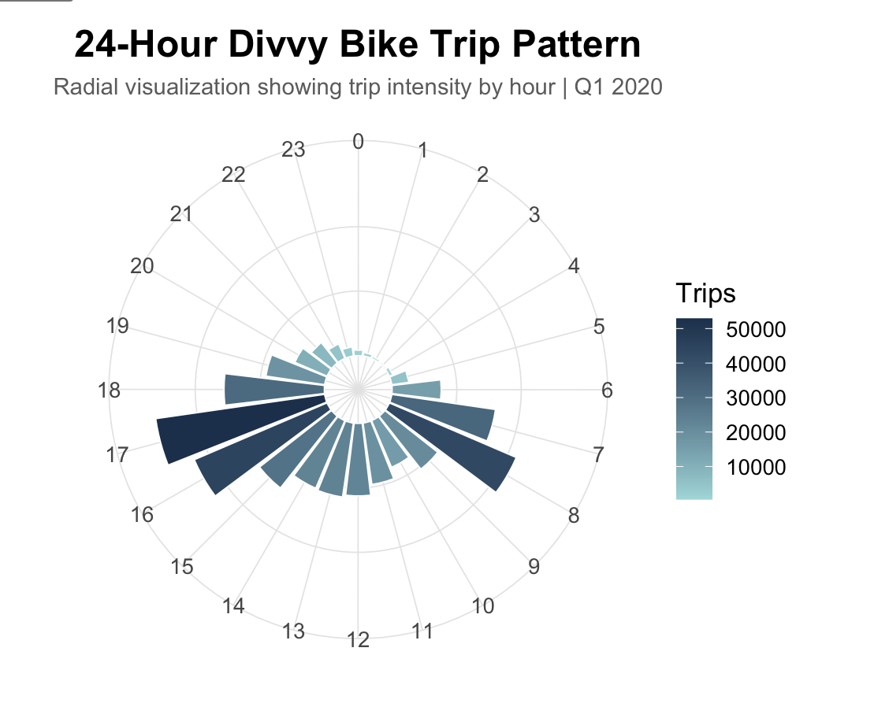
Observation :
1. Commuter Pattern: Clear double-peak at morning (7-9 AM) and evening (4-6 PM) rush hours indicate work-related usage dominates
Low Activity: Trips drop drastically during late night/early morning (12-5 AM), showing bikes are primarily used during active daytime hours
Alternate Visualization :

Slide 10
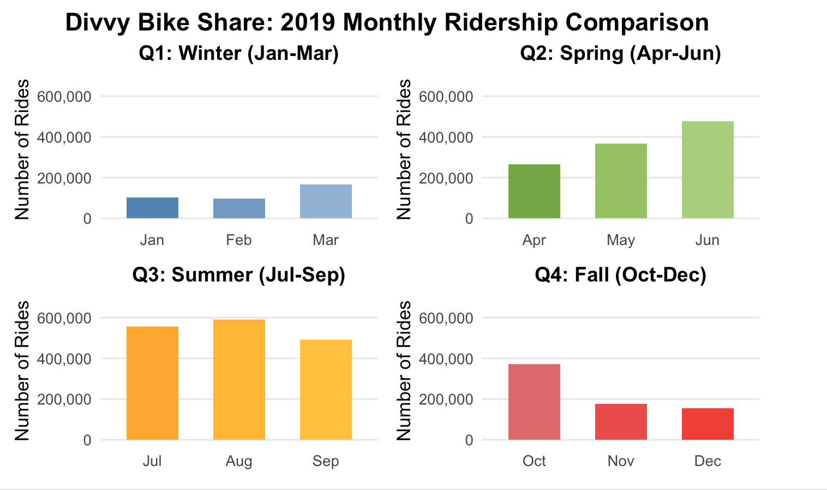
Visualization 5 – monthly ridership comparison

Slide 11
Observation :
The data reveals a dramatic seasonal pattern in bike-sharing usage throughout 2019.
Ridership starts low in winter months (January-February around 100,000 rides), steadily climbs through spring (March-June reaching nearly 500,000), peaks during summer months (July-August at approximately 600,000 rides), then sharply declines through fall and winter (October-December dropping back to around 150,000-180,000).

Slide 12
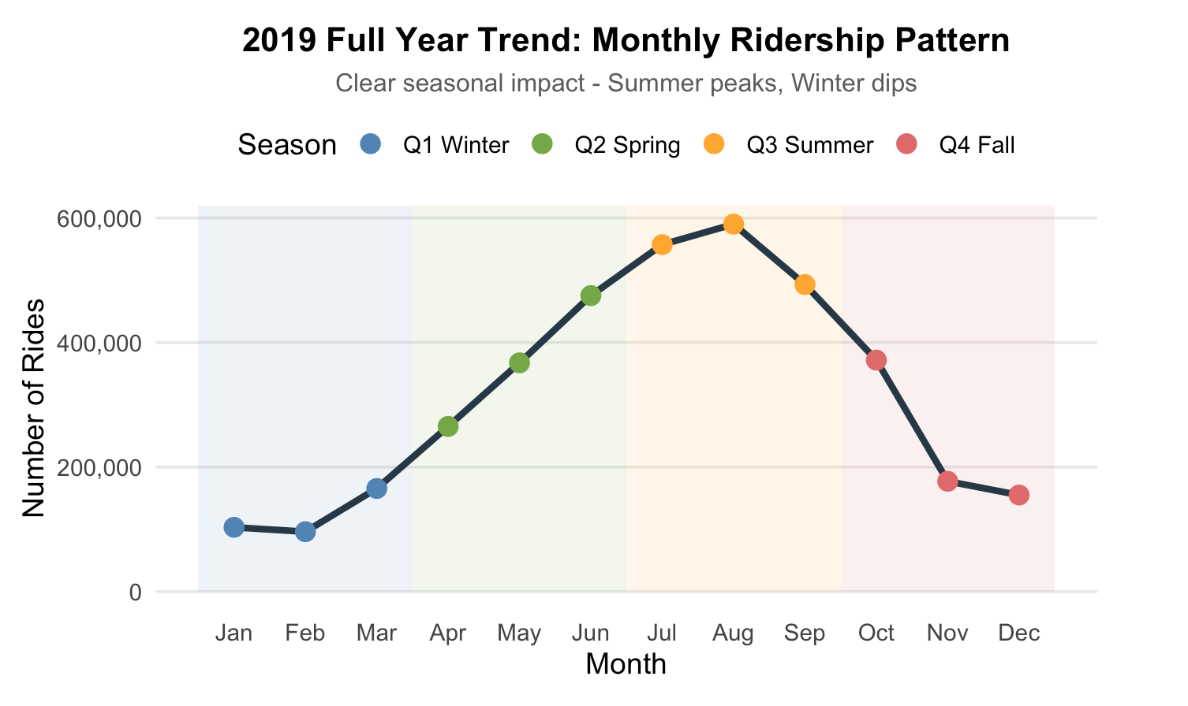
Monthly Ridership Pattern – Line graph

Slide 13
Limitation :
We obtained data from 2013 to 2022, so it does not include the most recent years.
The combined dataset for all years is very large, making it challenging to process efficiently in Tableau.
3. Although the dataset contains start and end station names, it does not include latitude and longitude values, which makes calculating the distance for each ride difficult.

Slide 14
Future Scope :
1. Integrate Real-Time or Latest Data : Expand the dashboard to include data from 2023–2025 for up-to-date trends.
Add real-time ride activity for live city mobility insights.
2. Distance & Route Optimization : Add latitude/longitude data to calculate actual ride distances.
3. Heatmaps & Advanced Geospatial Analysis : Create geospatial heatmaps for station popularity, high-demand zones, and underserved areas.
4. Recommendation System : Recommend the best time to ride, nearby stations, or alternative routes based on usage trends.

Slide 15

Thank you

